Slide 1
Linear Regression
Lecture 1
Robert Kissell
Fall 2017

Slide 2
Lecture - Outline
Regression Analysis
Types of Models
Ordinary Least Squares
Regression Statistics
First Order Conditions
Risk Modeling & Covariance Estimation

Slide 3
Types of Regression Models
Linear Regression
Simple, Multiple, CAPM, Return-Risk Factor Models
Polynomial Regression
Linear, Quadratic, Square Root, Cubic
Market Impact Models, Portfolio Optimization
Log-Linear Regression
Cobb-Douglas Production Function (Economics), Market Impact Models
Probability Model
Logit, Probit, LOM (Limit Order Models), SOR (Smart Order Routers)
Non-Linear Model
Market Impact Models, Sports Models

Slide 4
Regression Models – Solution Techniques
Linear Regression
Solve via Ordinary Least Squares (OLS)
Polynomial Regression
A regression equation that is linear in parameters.
The variables may have exponents that are not one,
Solve via Ordinary Least Squares (OLS)
Log-Linear Regression
Convert to Linear Model, solve via OLS
Need to Adjust for Error Term (Log-Normal)
Probability Model
Solve via Maximum Likelihood Estimates (MLE)
Logit - Probability Model
Convert to Linear Model via Wins Ratio “p/(1-p)”
Do NOT need to adjust for Error Term
Solve via MLE, OLS is ok in some situations
Non-Linear Regression
More Difficult Transformation is Needed (if possible)
May need to solve via more complex estimation techniques such as Non-Linear OLS, MLE, GMM

Slide 5
Linear Regression

Slide 6
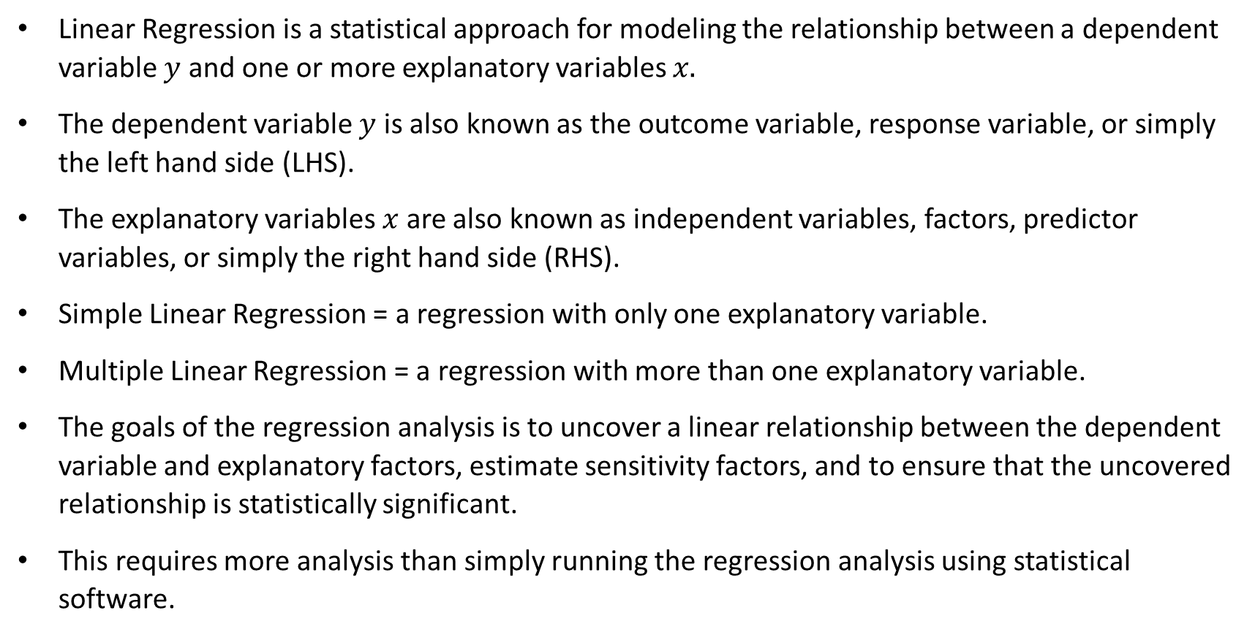
Linear Regression
Linear Regression is a statistical approach for modeling the relationship between a dependent variable $y$ and one or more explanatory variables $x.$
The dependent variable $y$ is also known as the outcome variable, response variable, or simply the left hand side (LHS).
The explanatory variables $x$ are also known as independent variables, factors, predictor variables, or simply the right hand side (RHS).
Simple Linear Regression = a regression with only one explanatory variable.
Multiple Linear Regression = a regression with more than one explanatory variable.
The goals of the regression analysis is to uncover a linear relationship between the dependent variable and explanatory factors, estimate sensitivity factors, and to ensure that the uncovered relationship is statistically significant.
This requires more analysis than simply running the regression analysis using statistical software.

Slide 7
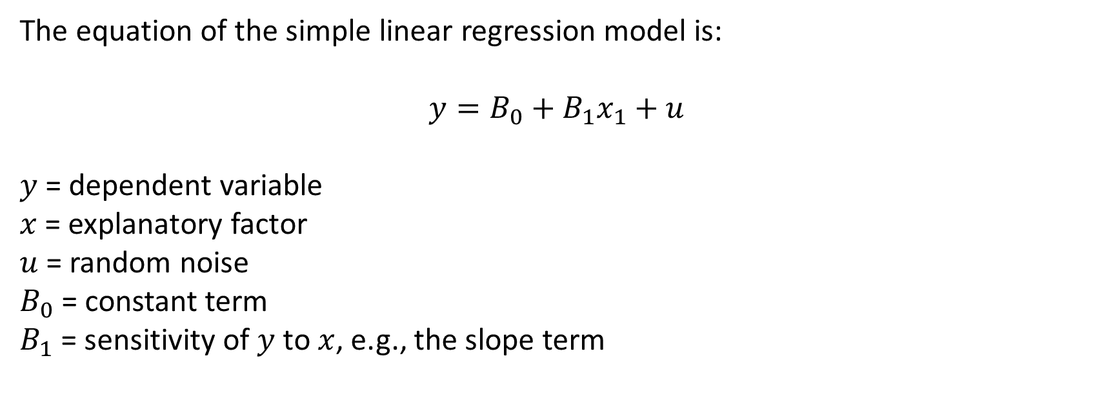
Simple Variable Model
The equation of the simple linear regression model is:
$$y=B_{0}+B_{1}x_{1}+u$$
$y$ = dependent variable
$x$ = explanatory factor
$u$ = random noise
$B_{0}$ = constant term
$B_{1}$ = sensitivity of $y$ to $x$, e.g., the slope term

Slide 8
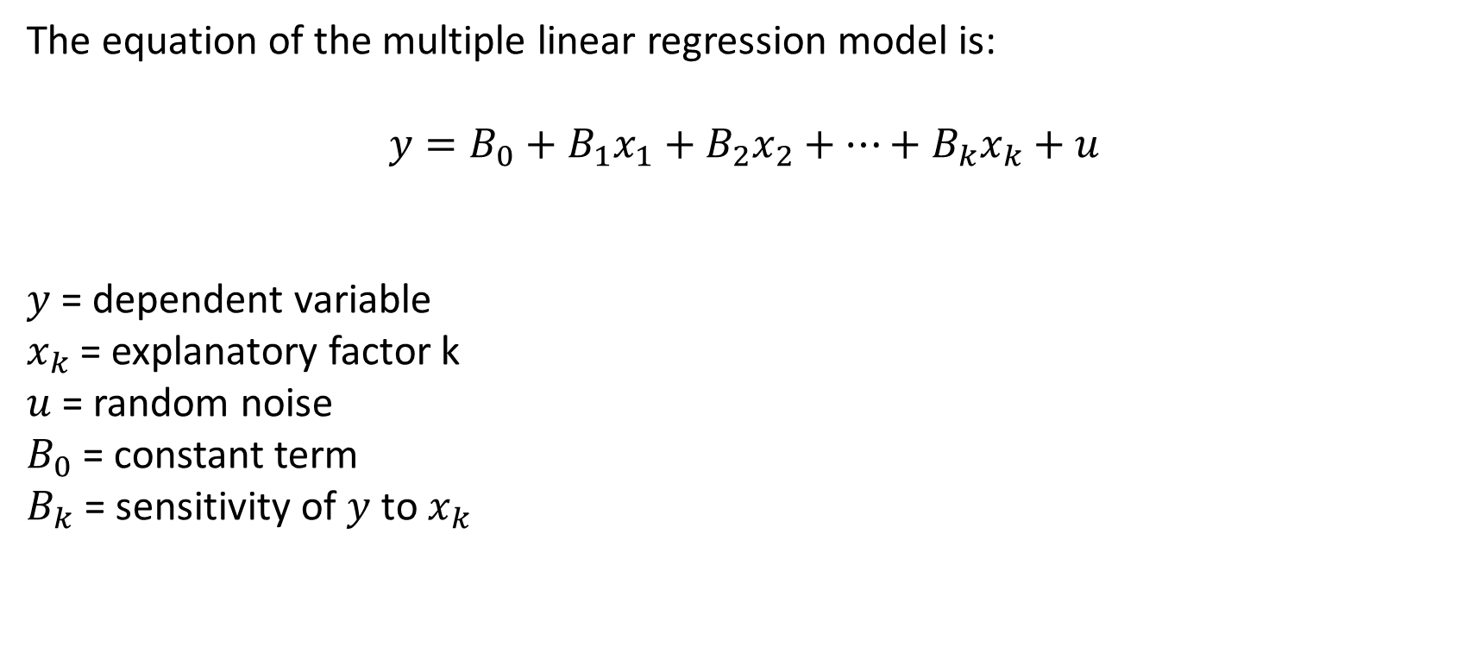
Multiple Variable Model
The equation of the multiple linear regression model is:
$$y=B_{0}+B_{1}x_{1}+B_{2}x_{2}+…+B_{k}x_{k}+u$$
$y$ = dependent variable
$x_{k}$ = explanatory factor k
$u$ = random noise
$B_{0}$ = constant term
$B_{k}$ = sensitivity of $y$ to $x_{k}$

Slide 9
Simple Linear Regression

Slide 10
Linear Regression

Slide 11
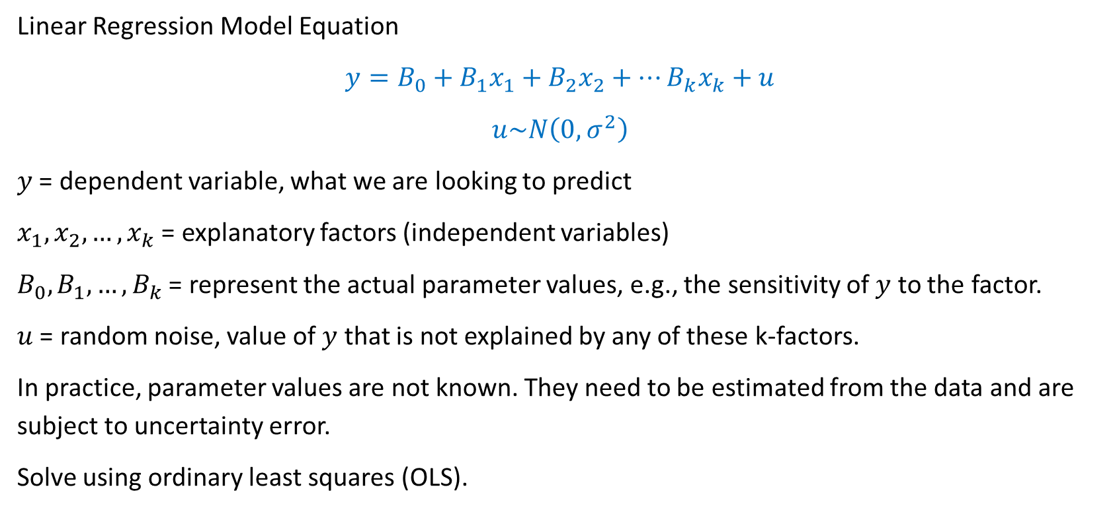
Linear Regression Model Equation – Actual Relationship
Linear Regression Model Equation
$$y=B_{0}+B_{1}x_{1}+B_{2}x_{2}+…B_{k}x_{k}+u$$
$$u\sim N\left(0,σ^{2}\right)$$
$y$ = dependent variable, what we are looking to predict
$x_{1},x_{2},…, x_{k}$ = explanatory factors (independent variables)
$B_{0},B_{1},…,B_{k}$ = represent the actual parameter values, e.g., the sensitivity of $y$ to the factor.
$u$ = random noise, value of $y$ that is not explained by any of these k-factors.
In practice, parameter values are not known. They need to be estimated from the data and are subject to uncertainty error.
Solve using ordinary least squares (OLS).

Slide 12
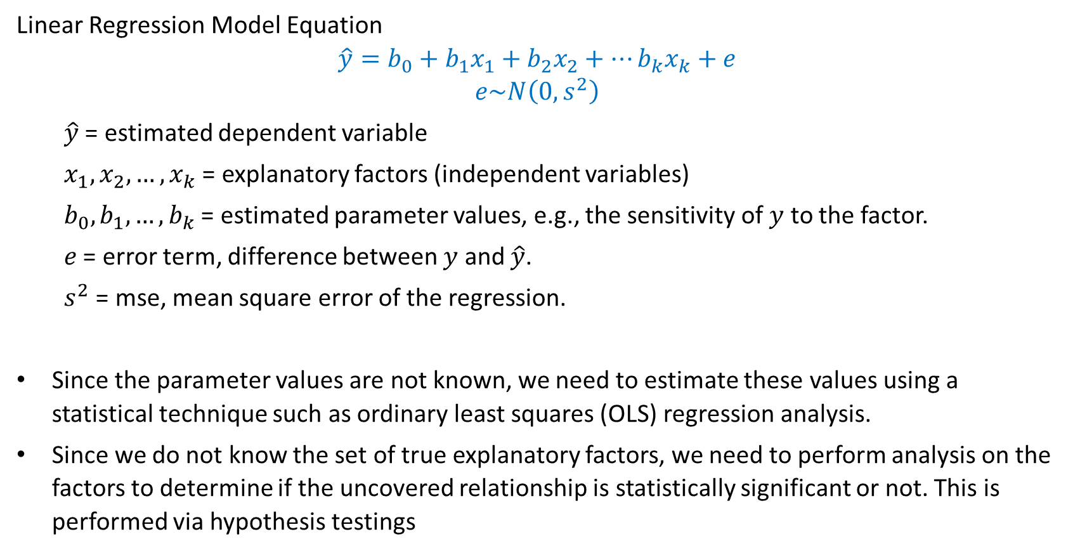
Linear Regression Model Equation – Estimated Relationship
Linear Regression Model Equation
$$\hat{y}=b_{0}+b_{1}x_{1}+b_{2}x_{2}+…b_{k}x_{k}+e$$
$$e\sim N\left(0,s^{2}\right)$$
$\hat{y}$ = estimated dependent variable
$x_{1},x_{2},…, x_{k}$ = explanatory factors (independent variables)
$b_{0},b_{1},…,b_{k}$ = estimated parameter values, e.g., the sensitivity of $y$ to the factor.
$e$ = error term, difference between $y$ and $\hat{y}$.
$s^{2}$ = mse, mean square error of the regression.
Since the parameter values are not known, we need to estimate these values using a statistical technique such as ordinary least squares (OLS) regression analysis.
Since we do not know the set of true explanatory factors, we need to perform analysis on the factors to determine if the uncovered relationship is statistically significant or not. This is performed via hypothesis testings

Slide 13
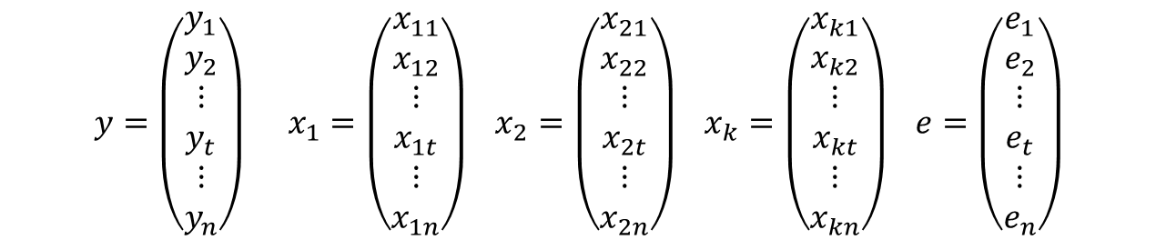
Solving the Linear Regression Model:
Regression Data Points
$$y=\left(\begin{matrix}\begin{matrix}y_{1} \\ y_{2}\end{matrix} \\ \begin{matrix}⋮ \\ y_{t}\end{matrix} \\ \begin{matrix}⋮ \\ y_{n}\end{matrix}\end{matrix}\right) x_{1}=\left(\begin{matrix}\begin{matrix}x_{11} \\ x_{12}\end{matrix} \\ \begin{matrix}⋮ \\ x_{1t}\end{matrix} \\ \begin{matrix}⋮ \\ x_{1n}\end{matrix}\end{matrix}\right) x_{2}=\left(\begin{matrix}\begin{matrix}x_{21} \\ x_{22}\end{matrix} \\ \begin{matrix}⋮ \\ x_{2t}\end{matrix} \\ \begin{matrix}⋮ \\ x_{2n}\end{matrix}\end{matrix}\right) x_{k}=\left(\begin{matrix}\begin{matrix}x_{k1} \\ x_{k2}\end{matrix} \\ \begin{matrix}⋮ \\ x_{kt}\end{matrix} \\ \begin{matrix}⋮ \\ x_{kn}\end{matrix}\end{matrix}\right) e=\left(\begin{matrix}\begin{matrix}e_{1} \\ e_{2}\end{matrix} \\ \begin{matrix}⋮ \\ e_{t}\end{matrix} \\ \begin{matrix}⋮ \\ e_{n}\end{matrix}\end{matrix}\right)$$

Slide 14
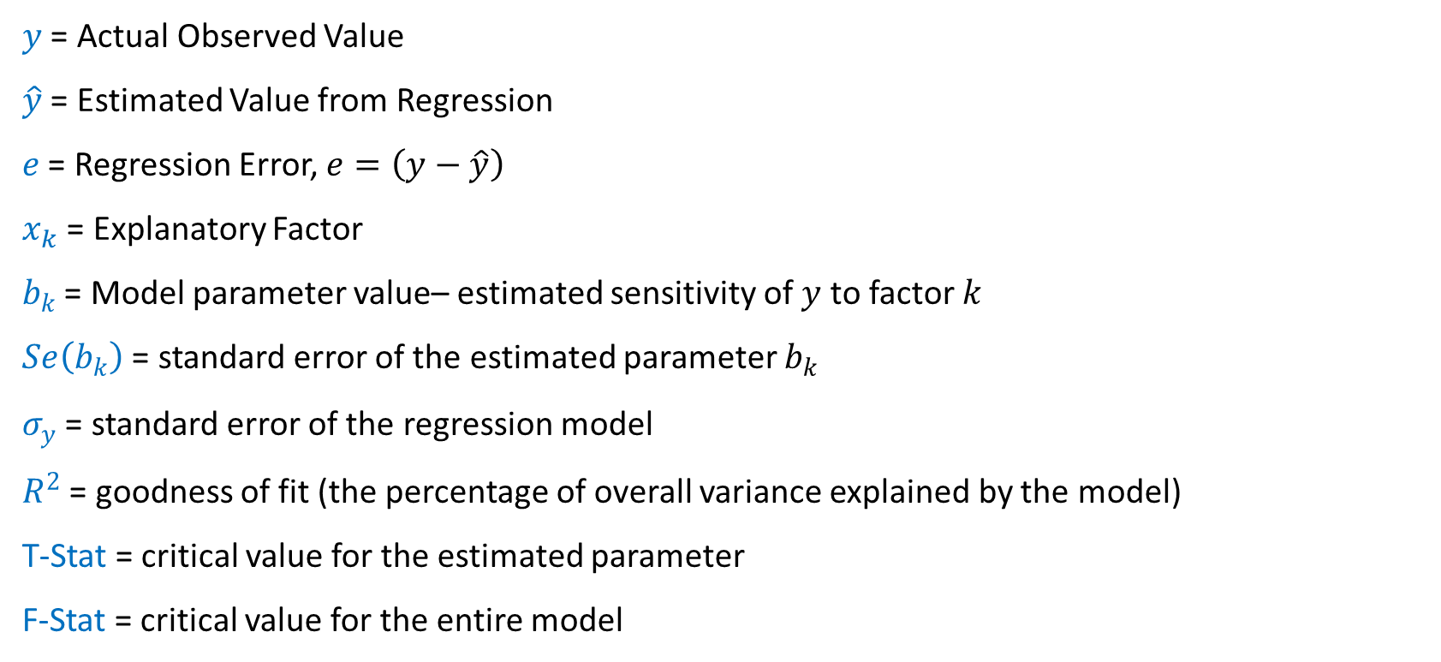
Regression Model Definitions:
$y$ = Actual Observed Value
$\hat{y}$ = Estimated Value from Regression
$e$ = Regression Error, $e=\left(y−\hat{y}\right)$
$x_{k}$ = Explanatory Factor
$b_{k}$ = Model parameter value– estimated sensitivity of $y$ to factor $k$
$Se\left(b_{k}\right)$ = standard error of the estimated parameter $b_{k}$
$σ_{y}$ = standard error of the regression model
$R^{2}$ = goodness of fit (the percentage of overall variance explained by the model)
T-Stat = critical value for the estimated parameter
F-Stat = critical value for the entire model

Slide 15

Multi-Regression Analysis
Linear Model:
$$y=β_{0}+β_{1}x_{1}+β_{2}x_{2}+ …+β_{k}x_{k}+ε$$
$$ε\sim N\left(0,σ^{2}\right)$$
Regression Model
$$y=b_{0}+b_{1}x_{1}+b_{2}x_{2}+ …+b_{k}x_{k}+e$$
$$e\sim N\left(0,s^{2}\right)$$
Estimation Model
$$\hat{y}=b_{0}+b_{1}x_{1}+b_{2}x_{2}+ …+b_{k}x_{k}$$

Slide 16

Error Function
Error Function:
$$e=\left(y−\hat{y}\right)$$
$$e=\left(y−\left(b_{0}+b_{1}x_{1}+ …+b_{k}x_{k}\right)\right)$$
$$e=\left(y−b_{0}−b_{1}x_{1}− …−b_{k}x_{k}\right)$$
Error Distribution:
$$e\sim N\left(0,s^{2}\right)$$
$$s^{2}=\frac{1}{n−k−1}\sum{{\left(y−\hat{y}\right)}^{2}}$$
Sum of Squared Error:
$$SSE=\sum{{\left(y−\hat{y}\right)}^{2}}=\sum{e^{2}}$$

Slide 17

Estimating Model Parameters
Minimize Sum of Square Error:
$$L=\sum{{\left(y−\hat{y}\right)}^{2}}=\sum{{\left(y−b_{0}−b_{1}x_{1}− …−b_{k}x_{k}\right)}^{2}}$$
First Order Conditions:
$$\frac{∂L}{∂b_{0}}=2\sum{\left(y−b_{0}−b_{1}x_{1}− …−b_{k}x_{k}\right)\left(−1\right)=0}$$
$$\frac{∂L}{∂b_{1}}=2\sum{\left(y−b_{0}−b_{1}x_{1}− …−b_{k}x_{k} \right)\left(−x_{1}\right)=0}$$
$$⋮$$
$$\frac{∂L}{∂b_{k}}=2\sum{\left(y−b_{0}−b_{1}x_{1}− …−b_{k}x_{k} \right)\left(−x_{k}\right)=0}$$

Slide 18
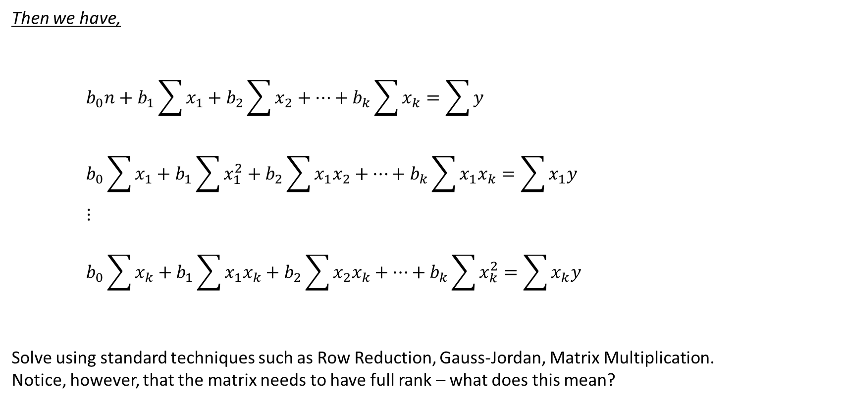
Estimating Model Parameters
Then we have,
$$b_{0}n+b_{1}\sum{x_{1}}+b_{2}\sum{x_{2}}+…+b_{k}\sum{x_{k}}=\sum{y}$$
$$b_{0}\sum{x_{1}}+b_{1}\sum{x_{1}^{2}}+b_{2}\sum{{x_{1}x}_{2}}+…+b_{k}\sum{{x_{1}x}_{k}}=\sum{x_{1}y}$$
$$⋮$$
$$b_{0}\sum{x_{k}}+b_{1}\sum{x_{1}x_{k}}+b_{2}\sum{{x_{2}x}_{k}}+…+b_{k}\sum{x_{k}^{2}}=\sum{x_{k}y}$$
Solve using standard techniques such as Row Reduction, Gauss-Jordan, Matrix Multiplication.
Notice, however, that the matrix needs to have full rank – what does this mean?

Slide 19

Solving Model Parameters
Model Parameters:
$$b_{0}=\overline{y}−b_{1}\overline{x_{1}}−b_{2}\overline{x_{2}}− …−b_{k}\overline{x_{k}}$$
$$b_{1}=\frac{\sum{\left(x_{1}−\overline{x_{1}}\right)\left(y−\overline{y}\right)}}{\sum{{\left(x_{1}−\overline{x_{1}}\right)}^{2}}}$$
$$⋮$$
$$b_{k}=\frac{\sum{\left(x_{k}−\overline{x_{k}}\right)\left(y−\overline{y}\right)}}{\sum{{\left(x_{k}−\overline{x_{k}}\right)}^{2}}}$$

Slide 20

Solving Model Parameters
Regression Error:
$$s^{2}=\frac{1}{n−k−1}\sum{{\left(y−\hat{y}\right)}^{2}}$$
Parameter Variance:
$$Var\left(b_{0}\right)=\sum{{\overline{x_{i}}}^{2}∙\frac{1}{\sum{\left(x_{i}−\overline{x_{i}}\right)}}}∙s^{2}$$
$$Var\left(b_{k}\right)=\frac{1}{\sum{\left(x_{k}−\overline{x_{k}}\right)}}∙s^{2}$$
Parameter Standard Error:
$$Se\left(b_{0}\right)=\sqrt{\sum{{\overline{x_{i}}}^{2}∙\frac{1}{\sum{\left(x_{i}−\overline{x_{i}}\right)}}}∙s^{2}}$$
$$Se\left(b_{k}\right)=\sqrt{\frac{1}{\sum{\left(x_{k}−{\overline{x}}_{k}\right)}}∙s^{2}}$$

Slide 21

Solving Model Parameters
$R^{2}$:
$$R^{2}=1−\frac{\sum{e_{i}^{2}}}{{\sum{\left(y−\overline{y}\right)}}^{2}}$$
T-Stat:
$$TStat=\frac{b_{k}}{Se\left(b_{k}\right)}$$
F-Stat:
$$FStat=\frac{{\sum{\left(\hat{y}−\overline{y}\right)}}^{2}}{{{\sum{\left(y−\hat{y}\right)}}^{2}}/{\left(n−2\right)}}$$

Slide 22
Matrix Multiplication – Parameter Estimation

Slide 23
Solving the Linear Regression Model:
Regression Data Points
$$y=\left(\begin{matrix}\begin{matrix}y_{1} \\ y_{2}\end{matrix} \\ \begin{matrix}⋮ \\ y_{t}\end{matrix} \\ \begin{matrix}⋮ \\ y_{n}\end{matrix}\end{matrix}\right) x_{1}=\left(\begin{matrix}\begin{matrix}x_{11} \\ x_{12}\end{matrix} \\ \begin{matrix}⋮ \\ x_{1t}\end{matrix} \\ \begin{matrix}⋮ \\ x_{1n}\end{matrix}\end{matrix}\right) x_{2}=\left(\begin{matrix}\begin{matrix}x_{21} \\ x_{22}\end{matrix} \\ \begin{matrix}⋮ \\ x_{2t}\end{matrix} \\ \begin{matrix}⋮ \\ x_{2n}\end{matrix}\end{matrix}\right) x_{k}=\left(\begin{matrix}\begin{matrix}x_{k1} \\ x_{k2}\end{matrix} \\ \begin{matrix}⋮ \\ x_{kt}\end{matrix} \\ \begin{matrix}⋮ \\ x_{kn}\end{matrix}\end{matrix}\right) e=\left(\begin{matrix}\begin{matrix}e_{1} \\ e_{2}\end{matrix} \\ \begin{matrix}⋮ \\ e_{t}\end{matrix} \\ \begin{matrix}⋮ \\ e_{n}\end{matrix}\end{matrix}\right)$$

Slide 24
Linear Regression Model – Evaluating Results

Slide 25
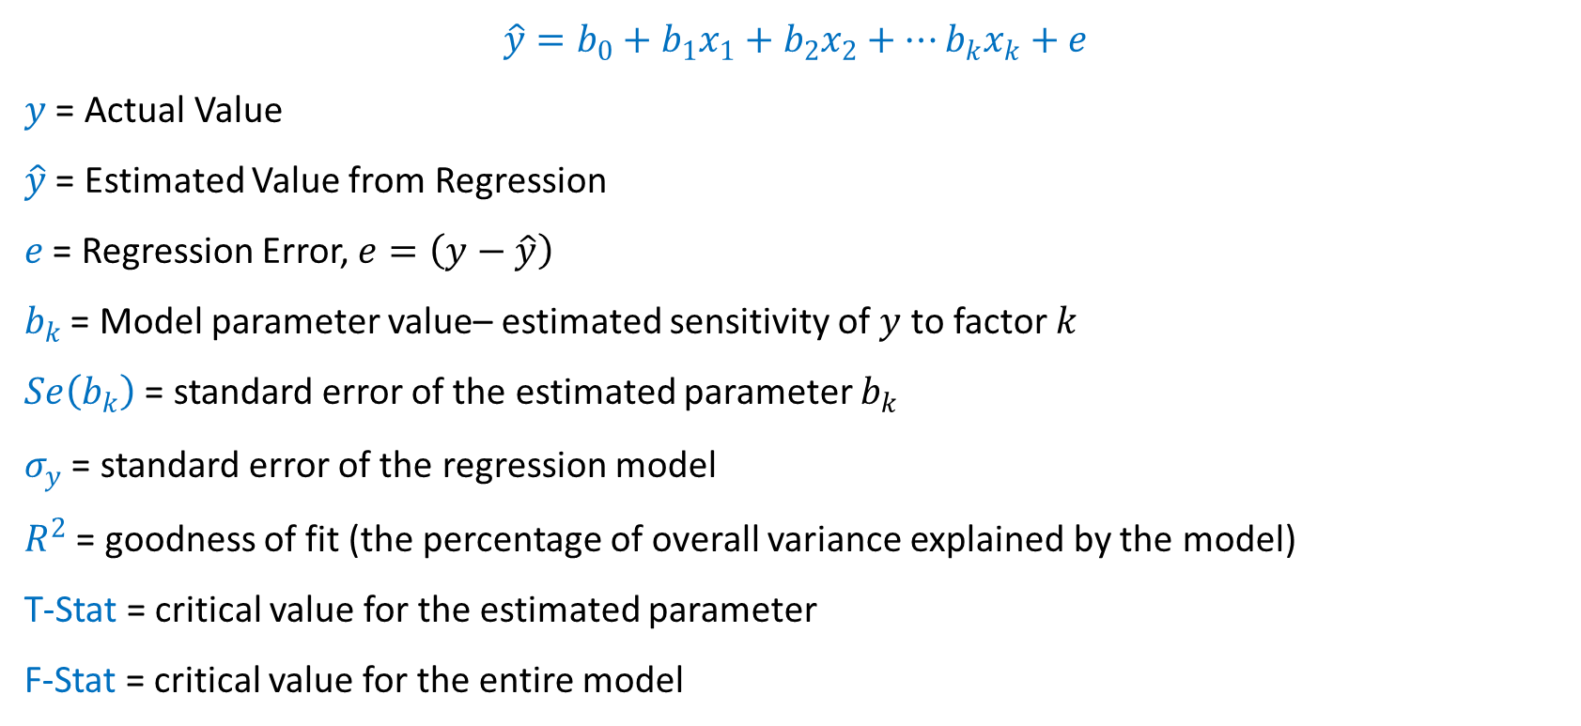
Regression Model:
$$\hat{y}=b_{0}+b_{1}x_{1}+b_{2}x_{2}+…b_{k}x_{k}+e$$
$y$ = Actual Value
$\hat{y}$ = Estimated Value from Regression
$e$ = Regression Error, $e=\left(y−\hat{y}\right)$
$b_{k}$ = Model parameter value– estimated sensitivity of $y$ to factor $k$
$Se\left(b_{k}\right)$ = standard error of the estimated parameter $b_{k}$
$σ_{y}$ = standard error of the regression model
$R^{2}$ = goodness of fit (the percentage of overall variance explained by the model)
T-Stat = critical value for the estimated parameter
F-Stat = critical value for the entire model

Slide 26
$R^{2}$ Goodness of Fit - Comparison

Slide 27
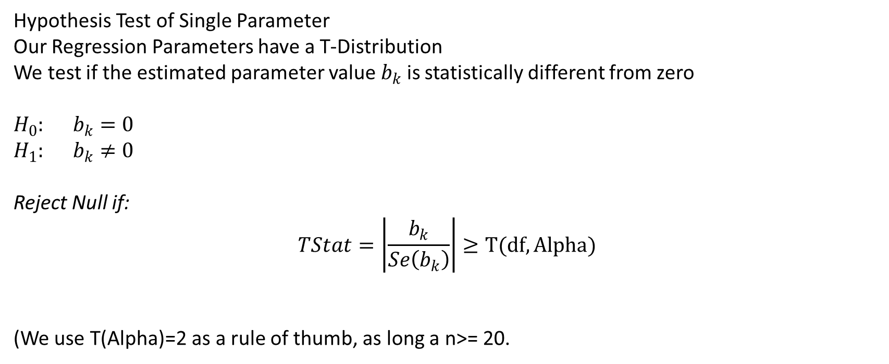
T-Test Example
Hypothesis Test of Single Parameter
Our Regression Parameters have a T-Distribution
We test if the estimated parameter value $b_{k}$ is statistically different from zero
$H_{0}:$ $b_{k}=0$
$H_{1}:$ $b_{k}≠0$
Reject Null if:
$$TStat=\left|\frac{b_{k}}{Se\left(b_{k}\right)}\right|≥T(df,Alpha)$$
(We use T(Alpha)=2 as a rule of thumb, as long a n>= 20.

Slide 28
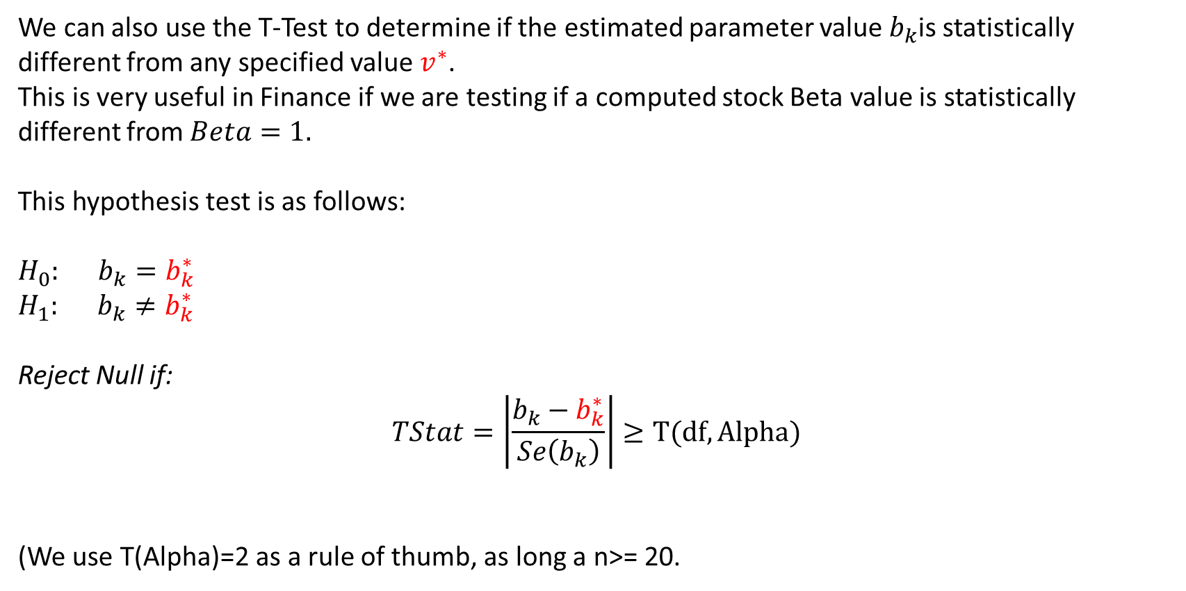
T-Test Example
We can also use the T-Test to determine if the estimated parameter value $b_{k}$is statistically different from any specified value $v^{∗}$.
This is very useful in Finance if we are testing if a computed stock Beta value is statistically different from $Beta=1.$
This hypothesis test is as follows:
$H_{0}:$ $b_{k}=b_{k}^{∗}$
$H_{1}:$ $b_{k}≠b_{k}^{∗}$
Reject Null if:
$$TStat=\left|\frac{b_{k}−b_{k}^{∗}}{Se\left(b_{k}\right)}\right|≥T(df,Alpha)$$
(We use T(Alpha)=2 as a rule of thumb, as long a n>= 20.

Slide 29
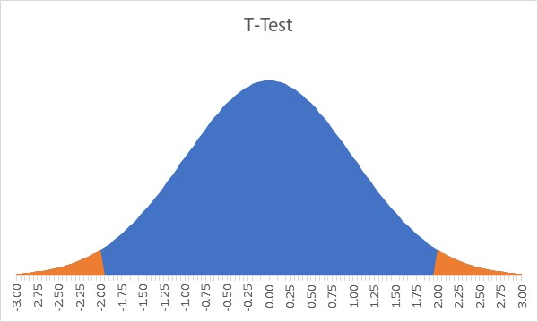
T-Test Example
Fail to Reject Null if -2<TStat<2
Reject Null if Tstat >=2 or <=-2

Slide 30
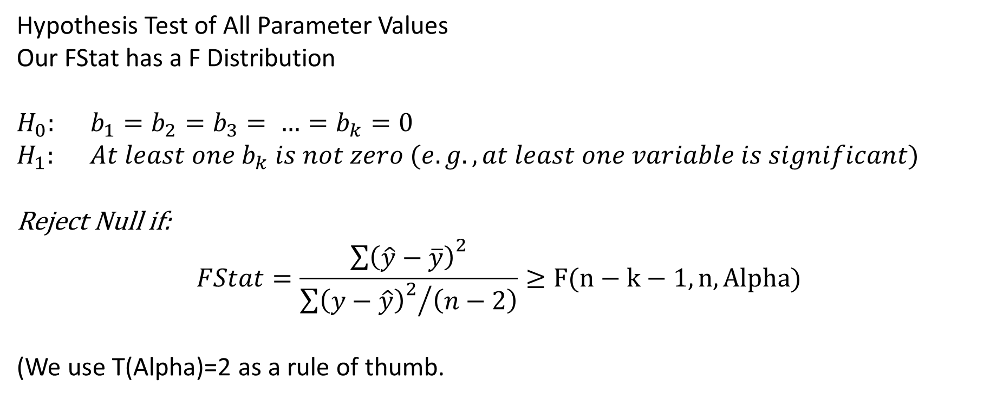
F-Test Example
Hypothesis Test of All Parameter Values
Our FStat has a F Distribution
$H_{0}:$ $b_{1}=b_{2}=b_{3}= …=b_{k}=0$
$H_{1}:$ $At least one b_{k} is not zero (e.g., at least one variable is significant)$
Reject Null if:
$$FStat=\frac{{\sum{\left(\hat{y}−\overline{y}\right)}}^{2}}{{{\sum{\left(y−\hat{y}\right)}}^{2}}/{\left(n−2\right)}}≥F(n−k−1,n,Alpha)$$
(We use T(Alpha)=2 as a rule of thumb.

Slide 31
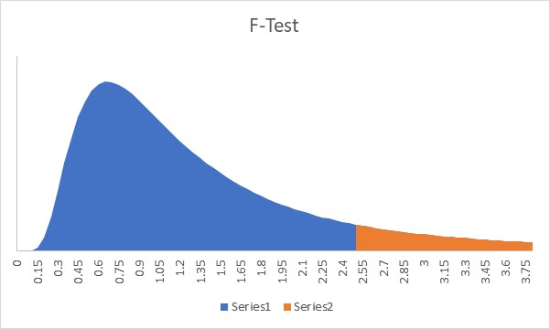
F-Test Example
Fail to Reject Null if FStat
Reject Null if FStat

Slide 32
Comparison of TTest & FTest

Slide 33
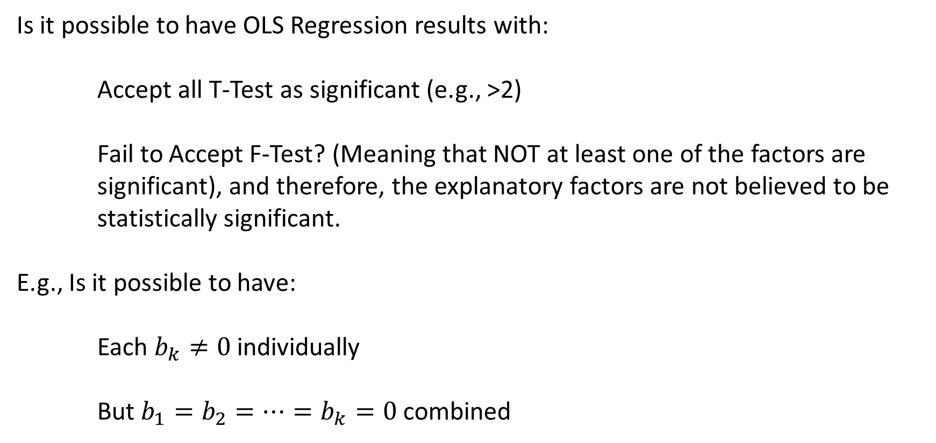
Question #1
Is it possible to have OLS Regression results with:
Accept all T-Test as significant (e.g., >2)
Fail to Accept F-Test? (Meaning that NOT at least one of the factors are significant), and therefore, the explanatory factors are not believed to be statistically significant.
E.g., Is it possible to have:
Each $b_{k}≠0$individually
But $b_{1}=b_{2}=…=b_{k}=0$ combined

Slide 34
Question #1 - Solution
$$\hat{y}=b_{0}+b_{1}x_{1}+b_{2}x_{2}+b_{3}x_{3}$$
In this regression we have significant T-Test for each parameter, and we have a significant F-Test for all the parameters together.

Slide 35

Question #2
Now, let us
$$\hat{y}=b_{0}+b_{1}x_{1}+b_{2}x_{2}+b_{3}x_{3}$$
Let,
$$Y= rand()∗10$$
$$X_{1}=rand()$$
$$X_{2}=rand()$$
$$X_{3}=rand()$$

Slide 36
Question #2 - Solution
$$\hat{y}=b_{0}+b_{1}x_{1}+b_{2}x_{2}+b_{3}x_{3}$$
In this regression we have high R2 and significant T-Test for each parameter, but the F-Test for all the parameters together is not significant. Therefore, this set of x factors is not significant predictors of the y variable. We cannot ignore the F-Test!
This makes sense since the x variables are random numbers.

Slide 37
Question #3
Now, let us
$$\hat{y}=b_{0}+b_{1}x_{1}+b_{2}x_{2}+b_{3}x_{3}$$
Let,
$$Y= rand()∗10$$
$$X_{1}=rand()$$
$$X_{2}=rand()$$
$$X_{3}=rand()$$

Slide 38
Question #3 - Solution
$$\hat{y}=b_{0}+b_{1}x_{1}+b_{2}x_{2}+b_{3}x_{3}$$
In this regression we have high R2 and significant F-Test, but the T-Test is insignificant for each variable.
Therefore, this set of x factors is not significant predictors of the y variable. We cannot ignore the F-Test!
This makes sense since the x variables are random numbers.

Slide 39
OLS Assumptions

Slide 40
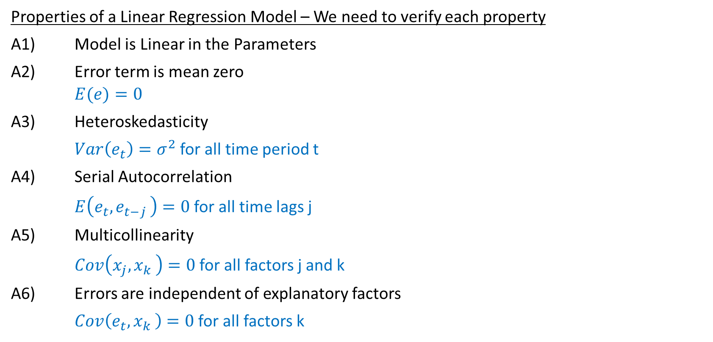
Linear Regression Model – Properties
Properties of a Linear Regression Model – We need to verify each property
A1) Model is Linear in the Parameters
A2) Error term is mean zero
$$E(e)=0$$
A3) Heteroskedasticity
$Var\left(e_{t}\right)=σ^{2}$ for all time period t
A4) Serial Autocorrelation
$E\left(e_{t}{,e}_{t−j}\right)=0$ for all time lags j
A5) Multicollinearity
$Cov\left(x_{j}{,x}_{k}\right)=0$ for all factors j and k
A6) Errors are independent of explanatory factors
$Cov\left(e_{t}{,x}_{k}\right)=0$ for all factors k

Slide 41
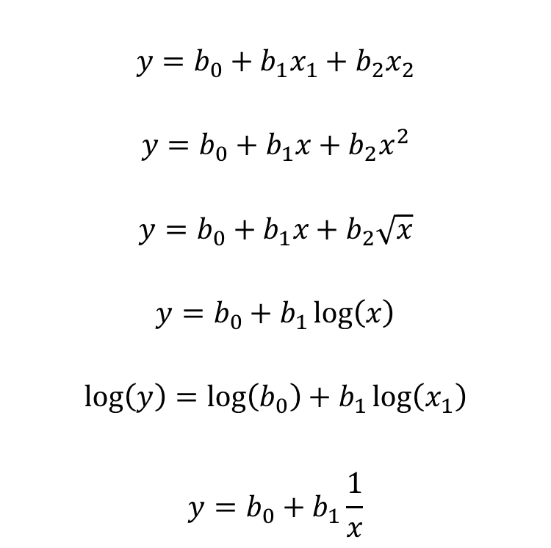
Models that are Linear in the Parameters
$$y=b_{0}+b_{1}x_{1}+b_{2}x_{2}$$
$$y=b_{0}+b_{1}x+b_{2}x^{2}$$
$$y=b_{0}+b_{1}x+b_{2}\sqrt{x}$$
$$y=b_{0}+b_{1}\log\left(x\right)$$
$$\log\left(y\right)=\log\left(b_{0}\right)+b_{1}\log\left(x_{1}\right)$$
$$y=b_{0}+b_{1}\frac{1}{x}$$

Slide 42

Models that are Not Linear in the Parameters
$$y=b_{1}b_{2}x$$
$$y=b_{1}+\frac{b_{2}}{b_{3}}x$$
$$y=b_{1}+x^{b1}$$
$$y=\sin\left(b_{1}x\right)$$
$$y=b_{0}x^{b1}x^{b2}$$
$$y=\frac{1}{1+\exp\left(−\left(b_{0}+b_{1}x_{1}+b_{2}x_{2}\right)\right)}$$

Slide 43
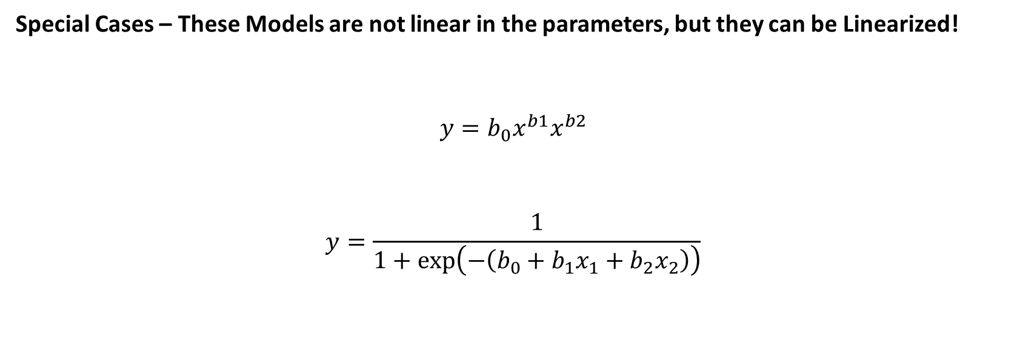
Models that can be Linearized
Special Cases – These Models are not linear in the parameters, but they can be Linearized!
$$y=b_{0}x^{b1}x^{b2}$$
$$y=\frac{1}{1+\exp\left(−\left(b_{0}+b_{1}x_{1}+b_{2}x_{2}\right)\right)}$$

Slide 44

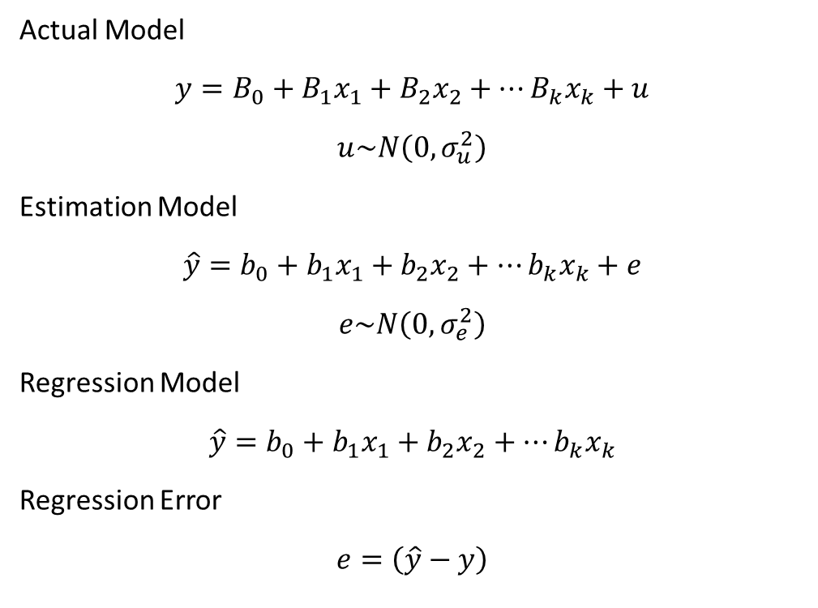
Solving the Linear Regression Model:
Actual Model
$$y=B_{0}+B_{1}x_{1}+B_{2}x_{2}+…B_{k}x_{k}+u$$
$$u\sim N\left(0,σ_{u}^{2}\right)$$
Estimation Model
$$\hat{y}=b_{0}+b_{1}x_{1}+b_{2}x_{2}+…b_{k}x_{k}+e$$
$$e\sim N\left(0,σ_{e}^{2}\right)$$
Regression Model
$$\hat{y}=b_{0}+b_{1}x_{1}+b_{2}x_{2}+…b_{k}x_{k}$$
Regression Error
$$e=\left(\hat{y}−y\right)$$
Notation:
If,
$$z\sim N\left(0,σ^{2}\right)$$
Then,
Z is from a Normal Distribution
$$E(z)=0$$
$$V(z)=σ^{2}$$

Slide 45
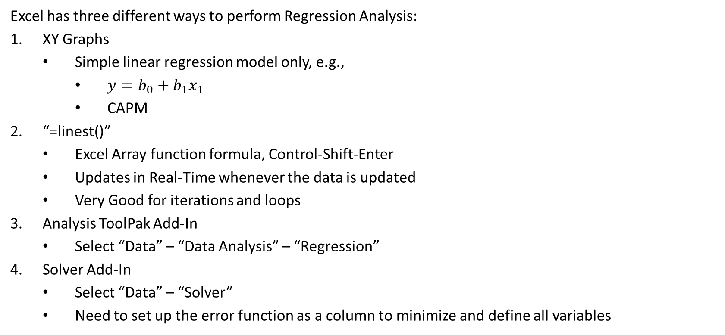
Regression in Excel
Excel has three different ways to perform Regression Analysis:
XY Graphs
Simple linear regression model only, e.g.,
$y=b_{0}+b_{1}x_{1}$
CAPM
“=linest()”
Excel Array function formula, Control-Shift-Enter
Updates in Real-Time whenever the data is updated
Very Good for iterations and loops
Analysis ToolPak Add-In
Select “Data” – “Data Analysis” – “Regression”
Solver Add-In
Select “Data” – “Solver”
Need to set up the error function as a column to minimize and define all variables

Slide 46
Regressions in MATLAB
MATLAB has several different ways to Run Regressions:
Regress()
Need to add the constant column of 1’s
Regstats()
Need to specify the regression statistics to show
Fitlm()
Provides regression output in table form

Slide 47
Polynomial Regression

Slide 48
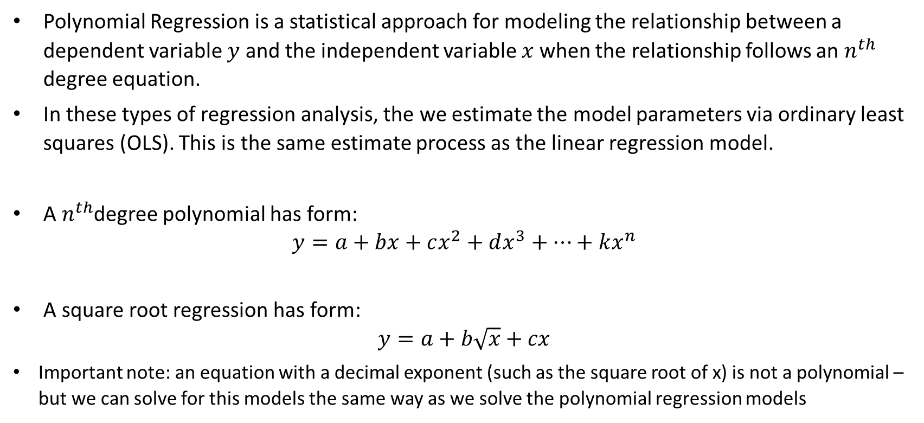
Polynomial & Square Root Regression
Polynomial Regression is a statistical approach for modeling the relationship between a dependent variable $y$ and the independent variable $x$ when the relationship follows an $n^{th}$ degree equation.
In these types of regression analysis, the we estimate the model parameters via ordinary least squares (OLS). This is the same estimate process as the linear regression model.
A $n^{th}$degree polynomial has form:
$$y=a+bx+cx^{2}+dx^{3}+…+kx^{n}$$
A square root regression has form:
$$y=a+b\sqrt{x}+cx$$
Important note: an equation with a decimal exponent (such as the square root of x) is not a polynomial – but we can solve for this models the same way as we solve the polynomial regression models

Slide 49

Types of Polynomial Equations
Linear Polynomial
$$y=a+bx$$
Quadratic Polynomial
$$y=a+bx+cx^{2}$$
Cubic Polynomial
$$y=a+bx+cx^{2}+dx^{3}$$
Square Root Regression
$$y=a+b\sqrt{x}+cx$$

Slide 50

Linear Polynomial
$$y=a+bx$$

Slide 51

Quadratic Polynomial
$$y=a+bx+cx^{2}$$

Slide 52

Cubic Polynomial
$$y=a+bx+cx^{2}+dx^{3}$$

Slide 53

Square Root Regression
$$y=a+b\sqrt{x}+cx$$

Slide 54

Solving Polynomial Regression Parameters
Quadratic Polynomial
$$\hat{y}=a+bx+cx^{2}$$
Error Term
$$e=\left(y−\hat{y}\right)$$
Sum Square Error
$$L=\sum{{\left(y−\hat{y}\right)}^{2}}$$
Sum Square Error (Expanded)
$$L=\sum{{\left(y− \left(a+bx+cx^{2}\right)\right)}^{2}}$$

Slide 55

Solving Quadratic Polynomial Regression Parameters
Minimize the Sum Square Error
$$L=\sum{{\left(y− \left(a+bx+cx^{2}\right)\right)}^{2}}$$
1) Compute the derivative of $L$ with respect to parametres $a, b, c$. E.g., find First Order Conditions (FOC).
2) Set derivative equal to zero and solve for each parameter
$$\frac{dL}{da}=0$$
$$\frac{dL}{db}=0$$
$$\frac{dL}{dc}=0$$
3) Solve for each parameter

Slide 56
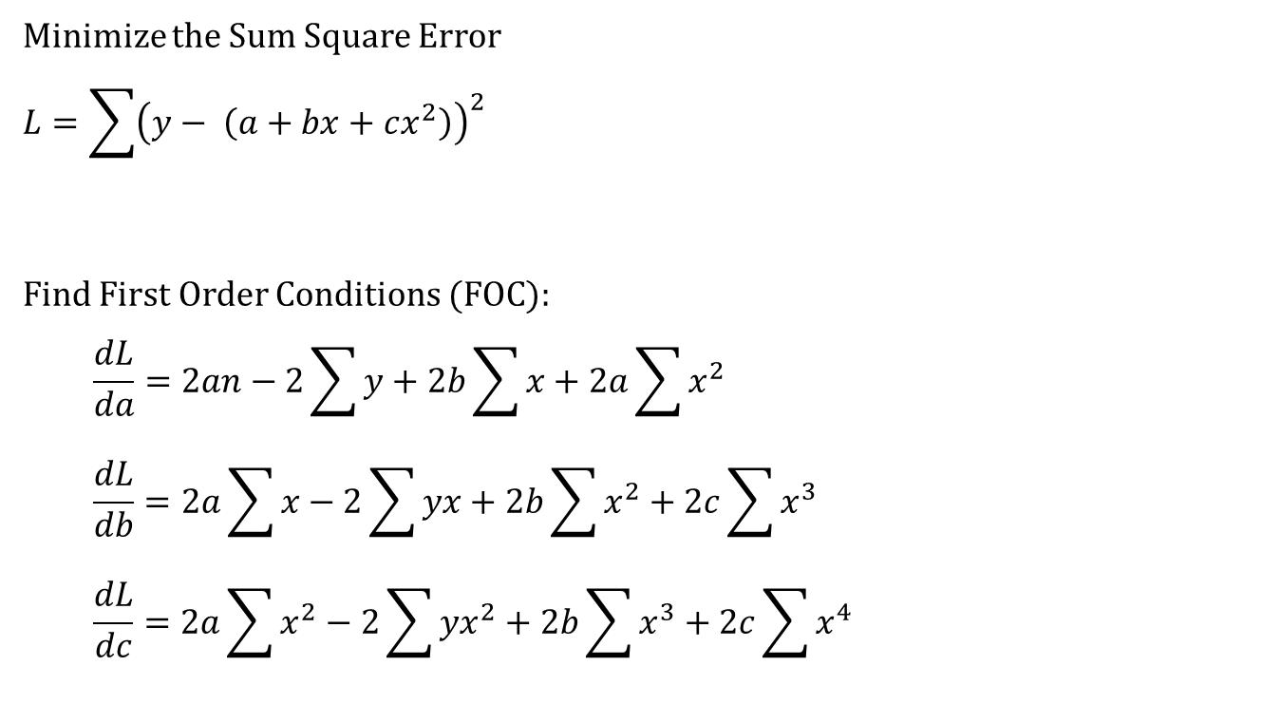
Solving Polynomial Regression Parameters
Minimize the Sum Square Error
$$L=\sum{{\left(y− \left(a+bx+cx^{2}\right)\right)}^{2}}$$
Find First Order Conditions (FOC):
$$\frac{dL}{da}=2an−2\sum{y}+2b\sum{x}+2a\sum{x^{2}}$$
$$\frac{dL}{db}=2a\sum{x}−2\sum{yx}+2b\sum{x^{2}}+2c\sum{x^{3}}$$
$$\frac{dL}{dc}=2a\sum{x^{2}}−2\sum{yx^{2}}+2b\sum{x^{3}}+2c\sum{x^{4}}$$

Slide 57
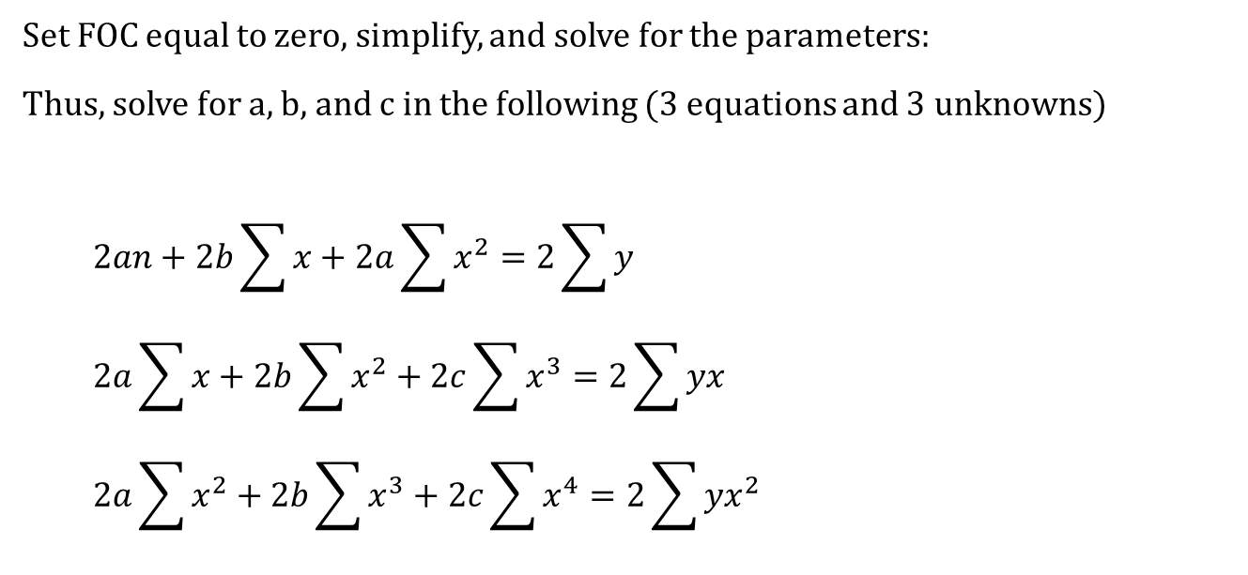
Solving Polynomial Regression Parameters
Set FOC equal to zero, simplify, and solve for the parameters:
Thus, solve for a, b, and c in the following (3 equations and 3 unknowns)
$$2an+2b\sum{x}+2a\sum{x^{2}}=2\sum{y}$$
$$2a\sum{x}+2b\sum{x^{2}}+2c\sum{x^{3}}=2\sum{yx}$$
$$2a\sum{x^{2}}+2b\sum{x^{3}}+2c\sum{x^{4}}=2\sum{yx^{2}}$$

Slide 58

Example - Linear Polynomial Regression
$$y=a+bx$$

Slide 59
Example - Linear Polynomial Regression
$$y=a+bx$$

Slide 60

Example – Quadratic Polynomial Regression
$$y=a+bx+cx^{2}$$

Slide 61
Example – Quadratic Polynomial Regression
$$y=a+bx+cx^{2}$$

Slide 62

Example – Cubic Polynomial Regression
$$y=a+bx+cx^{2}+dx^{3}$$

Slide 63
Example – Cubic Polynomial Regression
$$y=a+bx+cx^{2}+dx^{3}$$

Slide 64

Example – Square Root Regression
$$y=a+b\sqrt{x}+cx$$

Slide 65
Example – Square Root Regression
$$y=a+b\sqrt{x}+cx$$

